Slide 1
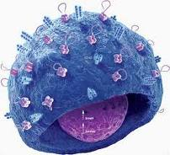
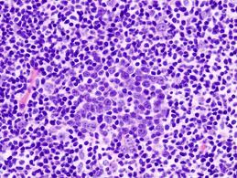
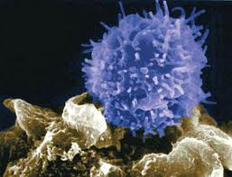
Infectious Diseases
Lesson 5.4

Slide 2
Lesson Objectives:
After finishing today’s lesson, you will be able to:
illustrate the basic sequence of events as the body responds to pathogens.
summarize the big picture view of body’s innate and adaptive immune responses.

Slide 3
Do Now
Spend 5 minutes reviewing the immune and pathogen cards.

Slide 4
Activity
Your group will be assigned one (or both) of the cases below:
Case 1. You are practicing on the football field and you fall down on the ground. Bacteria, some of them pathogens, stick to your hands. Later, on your way back to the locker room, your trip and fall cutting your hand deeply on a piece of shattered glass lying on the ground.
Case 2. You went out to your favorite restaurant. One of the waiters has a Norovirus infection (stomach flu caused by a virus). Since he is handling the bread rolls, with bare hands he is spreading it to the customers.
Using the immune cards you were given during lesson 5.1 and your notes from unit 5, illustrate the sequence of events your immune system will go through to protect you from the pathogens.

Slide 5
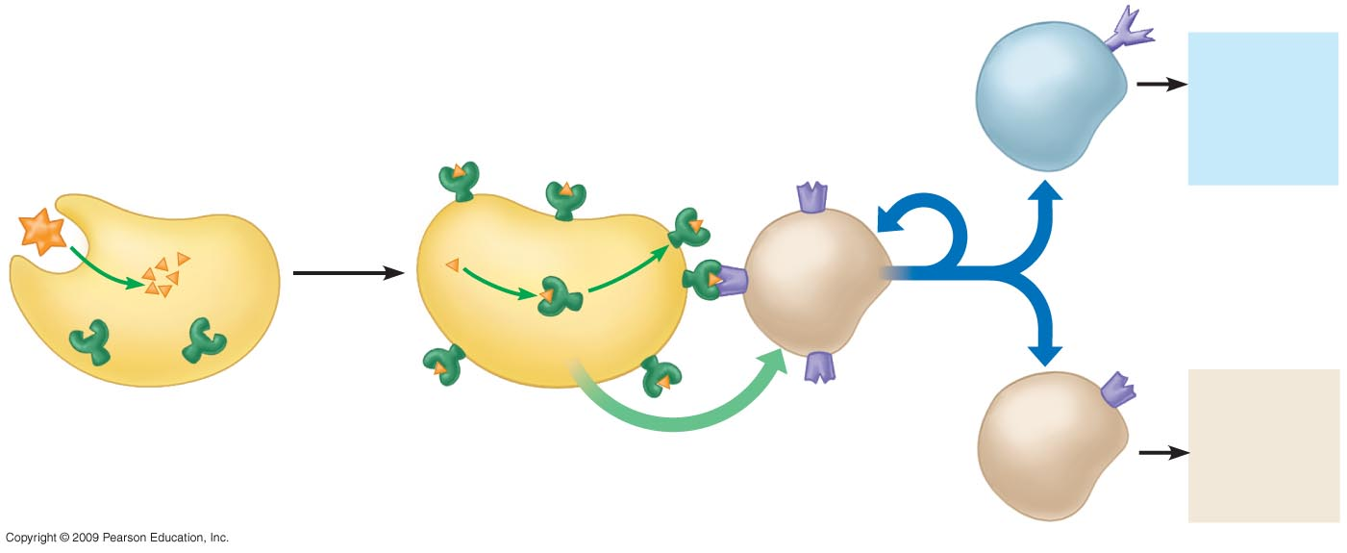
Wrap up: Putting it all together
Physical or
Chemical
barriers or
both
Antibodies and B cell memory
Self-nonself
complex
B cell
T cell
receptor
Cytokines
stimulate
cell division
Microbe
Macrophage
3
5
6
Cytokines
activate B cells
and other T cells
2
Helper
T cell
1
4
7
Self protein
Killing of infected host cells and memory
Antigen from microbe
(nonself molecule)
Antigen-presenting
cell
Cytokines
stimulates
helper T cell
Cytotoxic
T cell

Slide 6
The bottom line…
Innate responses
clear 99% of infections
Adaptive responses
do the rest
And they don’t forget ...

Slide 7
Homework
The immune system is our major defense system against pathogens. Write one paragraph on how you might be able to boost your immune system.

